Slide 1
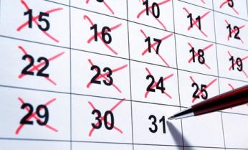
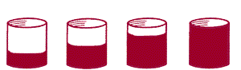
Continuous Estimation
Picking the right dates and quantities

Slide 2
Forecasting isn’t just about saying yes/no
We also care what about timing and amounts!
By what date will Bashar al-Assad vacate the office of president of Syria?
How many Japanese nuclear reactors will be operational by June 1, 2014? (This question appeared last year.)

Slide 3
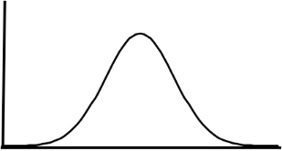
Thinking about Uncertainty
You can’t definitively know the answers in the advance but some quantities and dates are more likely than others.
Depending on what you know or learn about an event, you can weight one option more than another
The more you know the more you can assign higher probabilities to options, the less you know, the broader the possible range can be.
Know More
Know Less

Slide 4
Dealing with Uncertainty
People deal with uncertainty all the time:
How long will my commute be?
How much will my vacation cost?
What rate of return can I expect from my portfolio?
The goals of this training are to:
Introduce you to the continuous estimation (CE) format of forecasting problems.
Teach you to express uncertainty in quantitative terms and think about uncertainty in politics.
Explain how your forecasts will be scored.

Slide 5
Question Format
Every forecasting problem will be posed in the form of non-overlapping intervals that cover all possibilities.
Example : How many Japanese nuclear reactors will be operational as of June 1st, 2014?
0 reactors
1 to 4 reactors
5 to 9 reactors
10 or more reactors

Slide 6
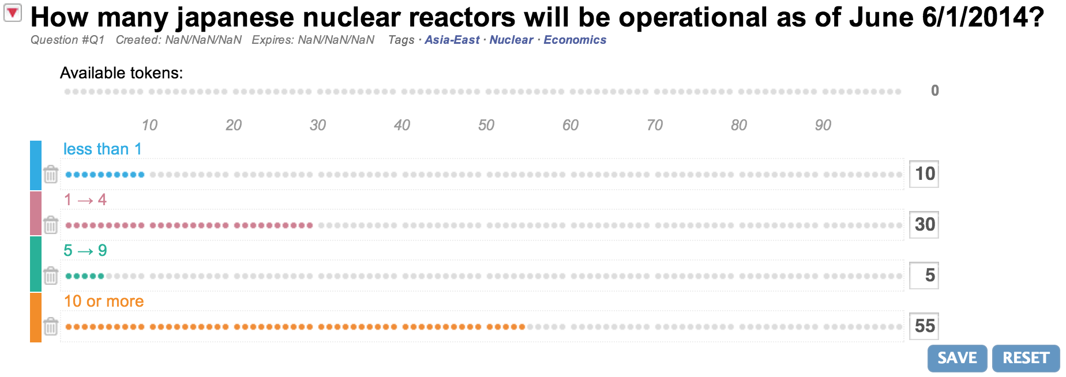
Answer Format
You have a total of 100 tokens to assign across all bins.
Each token represents 1% of your belief that the “bin” is the right one.
Put tokens into each bin until you’ve exhausted your token supply.
How many Japanese nuclear reactors will be operational as of June 1st, 2014?
0
When you are done, click “save”.
3
If you want to rest the number of tokens for a particular bin, click on the trash can icon.
2
You can assign as many as 100 (or as few as 0) by clicking on the line associated to each bin.
1

Slide 7
Tips on forecasting dates and quantities
Hunt for the right information– any clues as to what might happen and how similar events have resolved in the past.
Think about plausible scenarios that can lead to outcomes within each of the listed intervals.
Beware of overconfidence in some outcomes versus others. Why might your favored outcomes not occur?
Update your forecasts as you become aware of new information.
CHAMPS KNOW, the next training module will give you more detailed guidelines on making good forecasts.

Slide 8
How you’ll be scored
Our chosen metric is the Brier score:
A Brier score is the squared deviation between probability judgments and reality.
Brier scores range from 0 to 2 in this context.
Like in golf, lower scores reflect more accurate predictions!
Notes:
Following this slide, we could ask:
True or false: The best Brier score is 2.
Followed by either: Correct! The best Brier score is 0, indicating zero distance between your answer and the truth. The worst Brier score is 2.
Or: Incorrect. The Brier score is an error score: higher scores indicate greater distance between your forecast and the actual outcome. Therefore, the best Brier score is 0, indicating zero distance between your answer and the truth. The worst Brier score is 2.

Slide 9
Brier Scoring explained
Brier scoring harshly penalizes extreme overconfidence. Because errors are squared, your Brier score gets worse quickly with wrong extreme predictions. It also penalizes under-confidence in the long-run.
For example, consider these three forecasts for the question: Will Nouri al-Maliki be Prime Minister of Iraq on 9/30/2014? (Assume the true outcome is ‘No’)
Forecast #1: Probability ‘Yes’ = 50%. Brier Score = 2(0.5-0)² = 0.5
Forecast #2: Probability ‘Yes’ = 100%. Brier Score = 2(1-0)² = 2 (Worst possible score)
Forecast #3: Probability ‘Yes’ = 0%. Brier Score = 2(0-0)² = 0 (Best possible score)

Slide 10
Scoring Forecast Intervals
To score CE questions, we essentially break each larger question down into mini questions aligned to each bin. We then average the Brier Scores from the bins.
For example, the cumulative forecasted probability that 0 reactors will be operational is 10%, that there will be 4 or fewer operational reactors is 40%, and that there will be 9 0r fewer reactors is 45% . The correct answer is 0.
0
We then score the options in the following way:
Cut-Points | Outcome | Cumulative probability the Real value is less than the cut-point | Brier Scores
0 reactors | TRUE | 0.10 | 2*(0.10 - 1)² = 1.620
4 or fewer reactors | TRUE | 0.10 + 0.30 = 0.40 | 2*(0.40 - 1)² = 0.720
9 or fewer reactors | TRUE | 0.10 + 0.30 + 0.05 = 0.45 | 2*(0.45 - 1)² = 0.605
 |  | Ordinal Brier Score (average) = 0.982

Slide 11
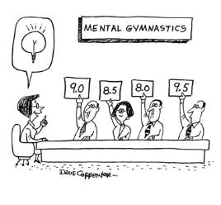
Scores over Time
We compute your score on each question daily.
For the best possible score, you should update your forecasts regularly.
If you don’t make a forecast on the first day a question is open, you will be assigned the median Brier score across all forecasters for each day, up to the day you make your first forecast.
Notes:
After this slide, we could ask:
How do I get scored before I have submitted my first forecast?
A Brier score of 0
A Brier score of 2
The average Brier score from those who have made a forecast
The median Brier score from those who have made a forecast

Slide 12
Leaderboard
During the season, everyone will be listed by their screen name and rank ordered by their mean Brier scores for all closed questions.
Do well and find yourself at the top of the leaderboard!

Slide 13
Setting the outer limits
Before you begin forecasting on any question, you will give the highest and lowest values that you think are feasible for the date or variable.
You will be asked for:
Lower bound: A value so low that there is only a 2% chance the actual outcome would be below it.
Upper bound: A value so high that there is only a 2% chance the actual outcome would be above it.
Notes:
From this slide on, these slides are only for those in the self-set condition.

Slide 14
How Wide or Narrow Should the Range Be?
Most people make the same mistake when setting confidence intervals: they fail to make the range wide enough.
When people estimate a 90% confidence interval, the truth often falls inside the range less than 50% of the time.
You will have to work hard to counteract the natural tendency to set your range too narrowly.
What might an extreme outcome look like? How could you potentially be surprised by the outcome?

Slide 15
How Wide or Narrow Should the Range Be?
You could make the range infinitely wide to be certain the value will fall within it. But that would be uninformative and useless as a forecast.
You could set the range very narrowly, but then it is unlikely to contain the correct answer.
Think carefully, using the strategies outlined earlier, and strike a balance.
Notes:
After this slide, we could ask:
What is the most common error people make when specifying a range of possible outcomes?
They set the range too narrowly
They set the range too wide
They are biased low
They are biased high

Slide 16
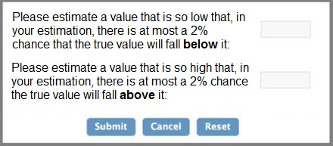
Response Format for Setting Ranges
You will be asked to provide your forecast bounds in a box such as that shown below.
Think carefully and give bounds that you think are wide enough that it has a 96% chance of containing the true value.

Slide 17
Scoring Ranges
In addition to using the Brier score to score probability forecasts, we will use a different scoring rule to score bounds.
For that purpose, we will use the Quantile Scoring Rule:
Quantile score = p( x – q ) + ( q – x )I,
q is one of the bounds you set
x is the true value that occurs
p is the cumulative probability associated with q (either 2% or 98%)
I is a variable that equals 1 if x < q and 0 if x > q.

Slide 18
Scoring Ranges
For Example:
I set bounds of 20 and 400.
The true answer is 60.
LOWER BOUND: 0.02(60-20) + (20-60)0=0.8
I=0 because 20<60.
UPPER BOUND: 0.98(60-400) + (400-60)1=6.8
I=1 because 400>60.
Average of my scores for each bound to get my Quantile Score: 0.8 and 6.8 = 3.8

Slide 19
Scoring Ranges
Because we want to be able to compare your Brier score with the score on your quantile range, we will rescale your quantile scores from 0 to 2.
The most accurate quantiles will receive a score of 2.
The least accurate quantiles will receive a score of 0.
Scores in between the best and the worst will be re-scaled linearly on to the 0-2 scale.

Slide 20
Quantile Scoring Rule
This Quantile Scoring Rule is designed to reward accuracy: you get the best score when you provide the most accurate quantiles.
We calculate this score for both of your bounds and take the average as your score.
While the range of this score varies depending on the values being estimated, we will scale the scores to be between 0 and 2, like the Brier score.
In addition to the leaderboard for Brier scores, there also will be a leaderboard for range scores.
With careful thought and good forecasting, you can be near the top of both leaderboards!

